Slide 1

INSTITUTE : UIE
DEPARTMENT : CSE
Bachelor of Engineering (Computer Science & Engineering)
Mobile Application Development(20CST-355)
TOPIC OF PRESENTATION:
Using the Tools of Mobile Interface Design
Prepared by:
Parveen Kumar Saini(E13339)
DISCOVER . LEARN . EMPOWER

Slide 2
Using the Tools of Mobile Interface Design

Slide 3
Interface Tools
What are user interface tools?
User interface (UI) design focuses on the visual experience of a digital product.
It encompasses all the colours, typography, and imagery you see on the screen—as well as the elements you use to navigate the interface, like buttons, scrollbars, and swiping actions.
What are mobile interfaces?
A mobile user interface (mobile UI) is the graphical and usually touch-sensitive display on a mobile device, such as a smartphone or tablet, that allows the user to interact with the device's apps, features, content and functions.

Slide 4
Interface Tools
What is interface design tools?
An interface design tool (IDT) is used for creating the user interface of a software application. This kind of tool provides features that help in the prototyping of a software application, and the level of prototype fidelity depends on the features provided by the tool.
What make a good mobile interface?
What makes a good mobile UI? A good mobile UI is composed of many things, but its primary goal is to make appealing and engaging designs for your target audience. Therefore, you should watch out for the color palette, multiple design principles, consistency, clarity, and above all, good user experience.

Slide 5
User interface (UI)
User interface (UI) design focuses on the visual experience of a digital product.
It encompasses all the colours, typography, and imagery you see on the screen—as well as the elements you use to navigate the interface, like buttons, scrollbars, and swiping actions.
Good UI design is essential to creating a delightful user experience.
So, if you’re a digital designer of any kind, you’ll need some reliable UI design tools in your toolbox.

Slide 6
9 of the best UI design tools worth trying in 2022.
1. Sketch
2. Adobe XD
3. UXPin
4. Marvel
5. Figma
6. InVision Studio
7. Zeplin
8. Origami Studio
9. Uizard

Slide 7
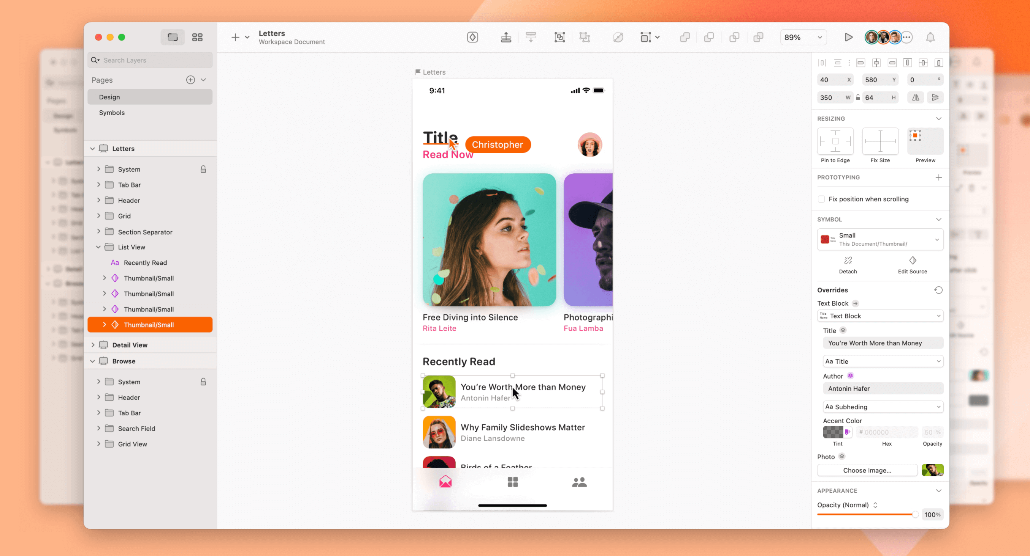
1. Sketch
Sketch is a vector graphics editor used for drawing, wireframing, prototyping and design handoff—essentially everything you need to bring your designs to life.

Slide 8
1. Sketch
Sketch is a powerful and flexible UX and UI design platform built for collaborative design.
It has long been considered an industry-standard tool, ideal for both beginner and advanced designers.
However, bear in mind that Sketch is only compatible with macOS.

Slide 9
Key features:
Intuitive vector editing tools and editable boolean operations for flexible and iterative design.
Infinite design canvas with flexible Artboards, design presets, customisable grids and simple resizing tools, allowing you to scale your designs to any screen size.
Shorthand and math operators to speed up the design process.
Variable and OpenType fonts for infinite control over your interface typography.
Cross-platform tools for real-time collaboration, feedback, sharing and developer handoff.

Slide 10
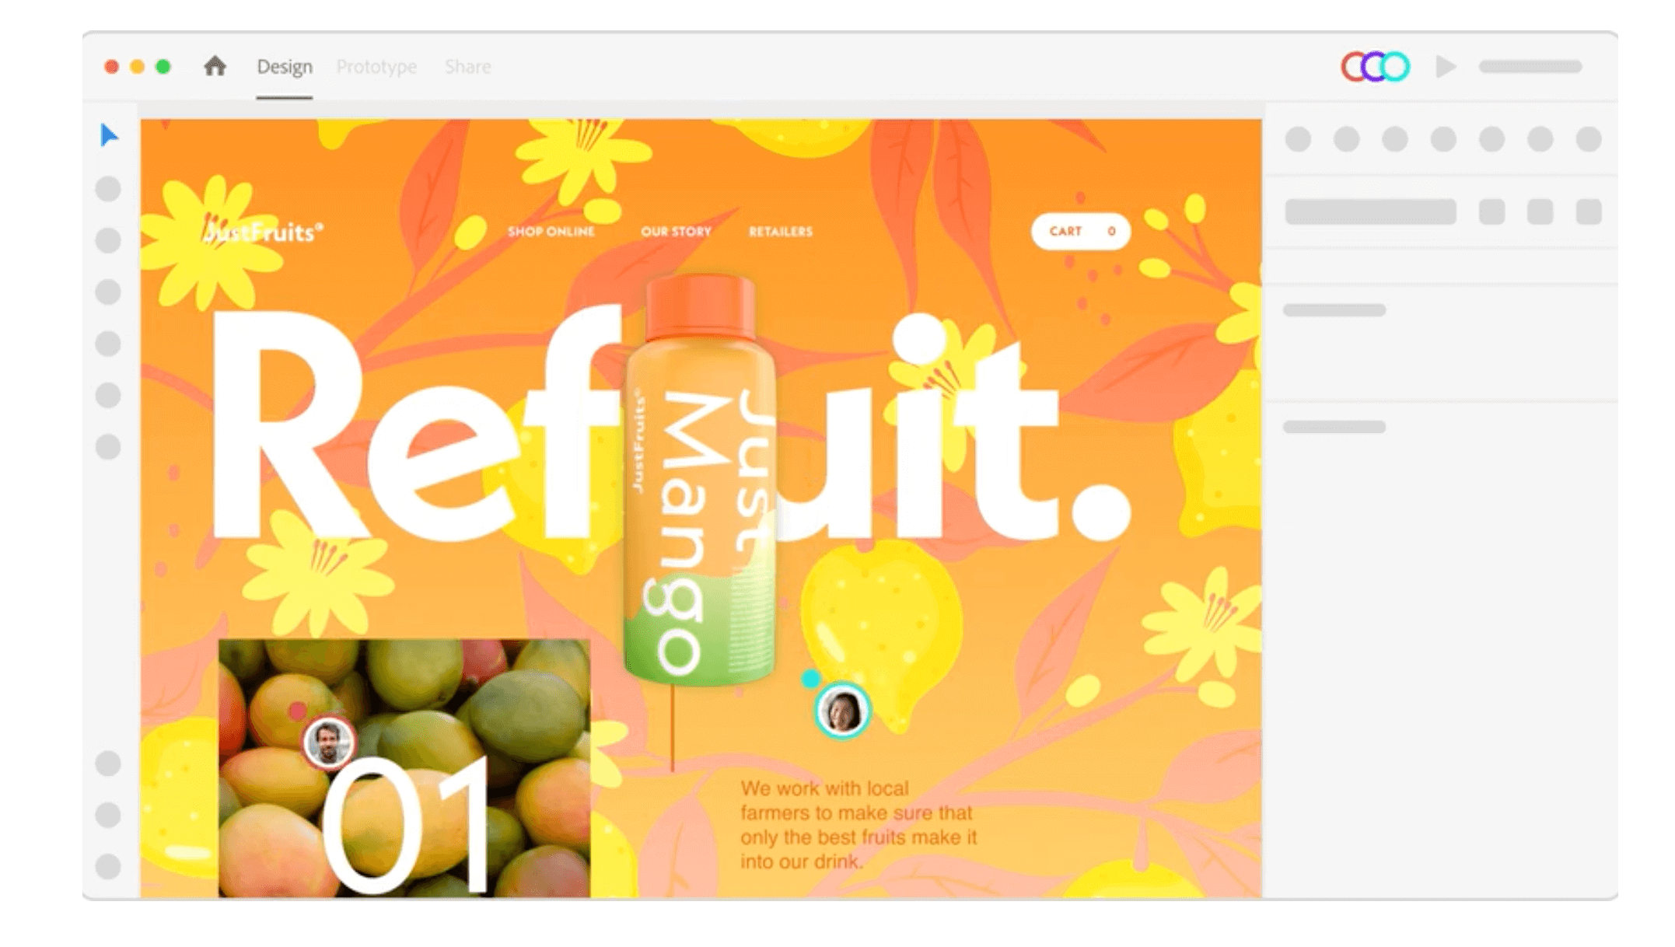
2. Adobe XD
Adobe XD is another all-encompassing vector-based UI tool packed with features for collaborative design and prototyping.

Slide 11
2. Adobe XD
Adobe XD is considered by many as the go-to design tool. It’s fast, it’s powerful, and there’s not a lot you can’t do with it!
From early ideation and low-fidelity designs, right through to impressive animations and true-to-life prototypes, Adobe XD will see you through the entire UX and UI design process.
Adobe XD is part of the Adobe Creative Cloud suite and can be used with both Windows and Mac, giving it a slight edge over Sketch.

Slide 12
Key features:
Vector-based drag-and-drop editor tool with unlimited artboards and smart guides that help you to align different objects and elements in your designs
UI kits (i.e. ready-made components) for Apple Design, Google Material Design, Amazon Alexa, and more
3D Transforms, allowing you to simulate object depth and perspective in your designs
Components and states for iterative and scalable design.
Components work intuitively to instantly push changes across entire designs or documents, sparing you the work of manually duplicating and implementing changes
Powerful animation functionality, including video and Lottie playback, micro-animations and motion effects, scroll groups and anchor links
Voice prototyping, enabling you to create voice commands, build in speech playback, and integrate voice-enabled features
Design Specs feature to streamline the handoff process, allowing you to share interactive prototypes, CSS code snippets and downloadable assets with developers—all via one link

Slide 13
3. UXPin
UXPin is a popular UX and UI tool, used by both new and seasoned designers alike.
UXPin is another end-to-end platform capable of delivering polished, interactive prototypes—no coding skills required.
If you’re already familiar with Sketch or Photoshop, you’ll find the UXPin interface fairly easy to navigate.
Not only does it come with thousands of ready-to-use design components; it’s also well-equipped to help you create and manage solid design systems.
UXPin works with Mac and Windows, or in the browser.

Slide 14
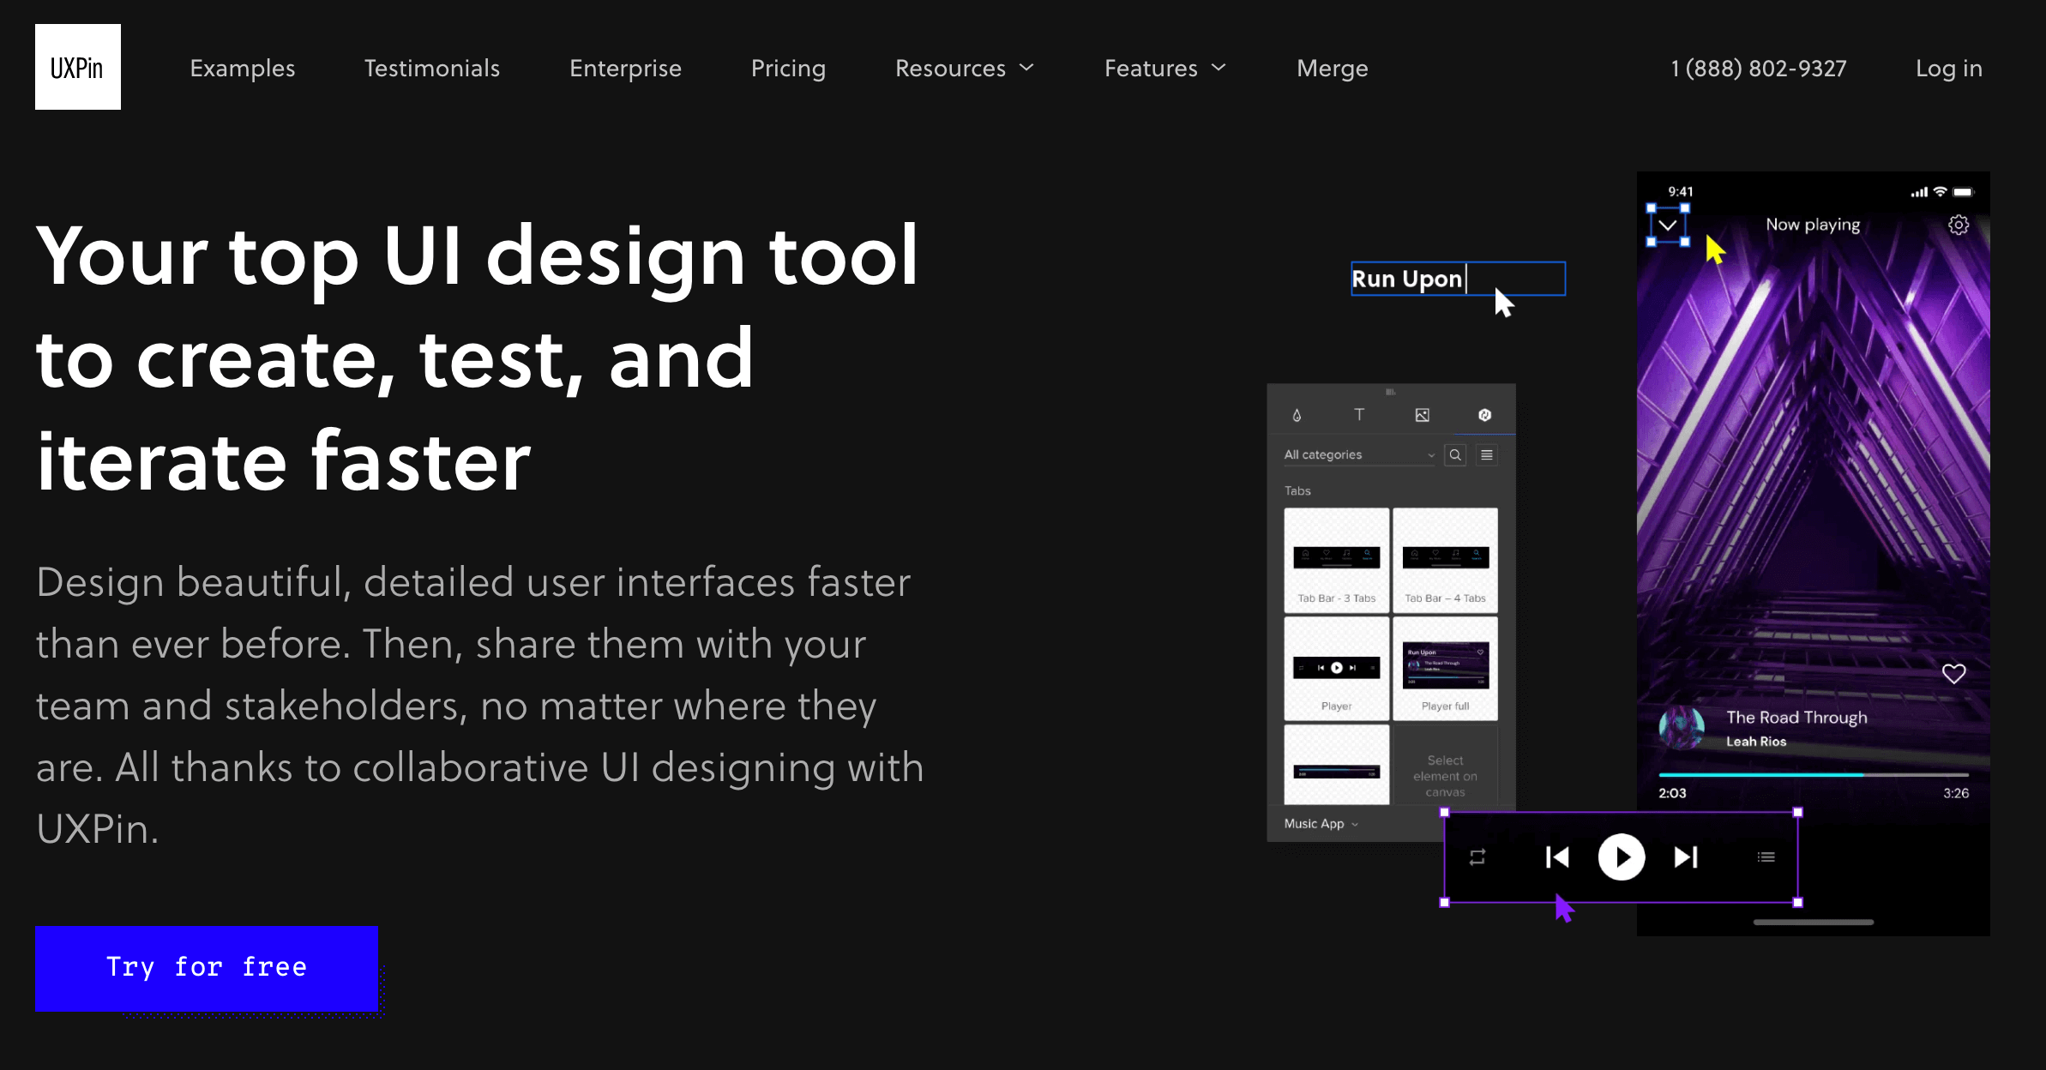
3. UXPin

Slide 15
Key features:
Built-in libraries for iOS, Google Material Design, Bootstrap and User Flows, full of ready-to-use interactive elements, colours, text styles and icons
Interactive components that you can drag into your designs to create high-fidelity interactions.
Embedded user flow capabilities to help you tell the story of your work.
Built-in contrast checker and colour blindness simulator to help you ensure your designs are as accessible and inclusive as possible.
Streamlined developer handoff with downloadable design specs

Slide 16
4. Marvel
Marvel promises all the core functionality you need to design and build digital products, including wireframing, prototyping, and design specs for handoff.
And, with its user-friendly and intuitive platform, it’s the ideal UX/UI design tool for beginners.
Marvel is a web-based tool that works in the browser, so you don’t need to download or install anything.
It has been built for simple, fast design, with features for wireframing, UI design, and prototyping.
Marvel also integrates with many other popular design tools to help you power up your workflow.

Slide 17
Key features:
Drag-and-drop wireframe templates for quick, early-stage designs
A vast collection of pre-made assets, images and icons to help you visualise your ideas
Option to import static designs from other tools (e.g. Sketch)
Interactive prototyping with hotspots, interactions and layers. You can learn more about how to use Marvel for prototyping (and about other prototyping tools) in this guide
Built-in user testing functionality to get feedback on your ideas and validate your designs
Design handoff tool to instantly turn designs into code, specs and assets for developers to use
Integrations for Jira, Maze, Confluence, Lookback, and more

Slide 18
5. Figma
You’ll struggle to find a UX/UI tools list that doesn’t mention Figma, and for good reason.
Figma is a browser-based interface design tool that empowers fast design and prototyping and a smooth, collaborative workflow.
Just like Sketch and Adobe XD, Figma is a vector graphics editor.
Figma is ideal if you’re looking for an all-in-one tool to cover everything from ideation to interactive prototyping—wrapped up in a delightfully intuitive interface.
And, if you do give Figma a go, be sure to try out FigJam, too—Figma’s online whiteboard tool for collaborative ideation, brainstorming and workshops.

Slide 19
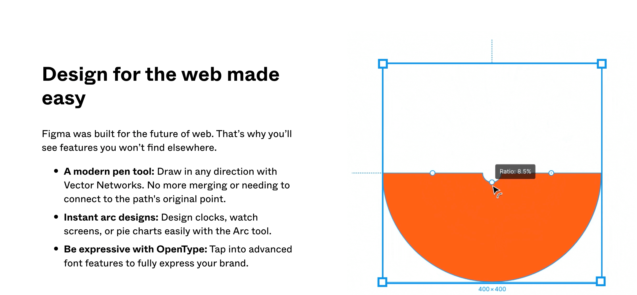
5. Figma

Slide 20
Key features:
Modern pen tool which allows you to draw in any direction with Vector Networks
Auto Layout for easy responsive design
Flexible Styles which you can apply across all your UI projects
Accessible libraries with ready-made assets which you can drag and drop into your design files
Code snippets for CSS, iOS, and Android, ensuring easy developer handoff
Plugins to automate and augment your design work
Interactive prototyping features including advanced transitions, dynamic overlays and animated GIFs
Embedded commenting functionality for a collaborative design process

Slide 21
6. InVision Studio
InVision Studio claims to be the most powerful screen design tool in the world, providing everything you need to draw, wireframe, prototype, and animate to perfection.
Part of the InVision suite of collaborative design tools, Studio comes with an intuitive vector-based drawing tool, an infinite canvas, and a multitude of impressive rapid prototyping features and built-in animations.
Compatible with both MacOS and Windows, it’s one of the most popular UX/UI tools out there for professional designers.

Slide 22
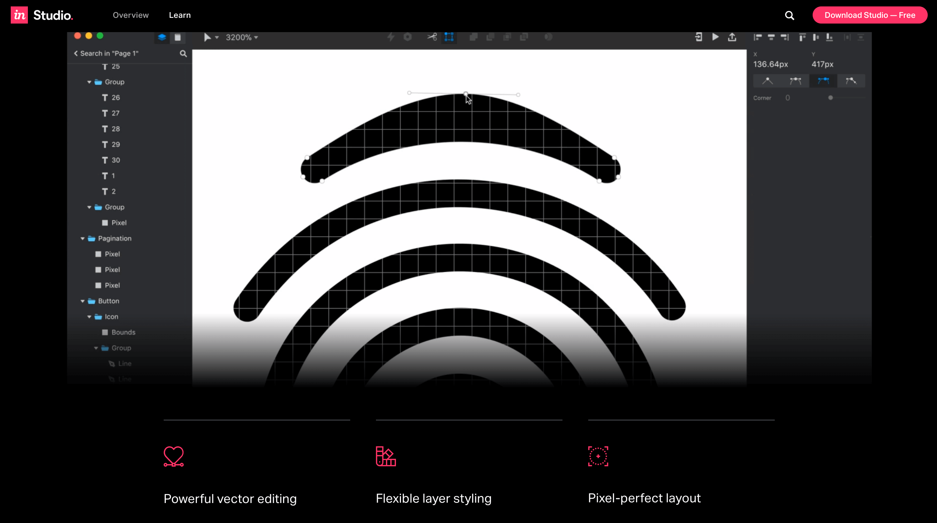
6. InVision Studio

Slide 23
Key features:
Vector-drawing tool for lightning-fast screen design.
Adaptive layout for responsive design, enabling you to quickly and easily adjust and scale your designs to fit any screen size.
Rapid prototyping functionality with fluid interactions, mobile device mirroring and instant playback.
Built-in animation capabilities, including smart-swipe transitions, timeline editing and auto-layer linking.
Shared component libraries with global syncing and real-time updates to ensure design consistency.
The Inspect tool for generating pixel-perfect specs for developers.

Slide 24
7. Zeplin
Zeplin is a cloud-based software that bridges the gap between UX/UI designers and frontend developers.
It provides an organised workspace to publish your designs and generate specs, assets and code snippets for a smooth developer handoff.
UX and UI designers work in close collaboration with developers—the people who code your designs into real, functioning websites and apps.
As such, it’s essential to provide developers with the technical specs they need to develop your designs exactly as you envision them.
Zeplin takes care of that whole process: you simply publish your finished designs in the platform and select what platform you’re designing for (e.g. web, iOS, or Android) to generate the necessary assets.

Slide 25
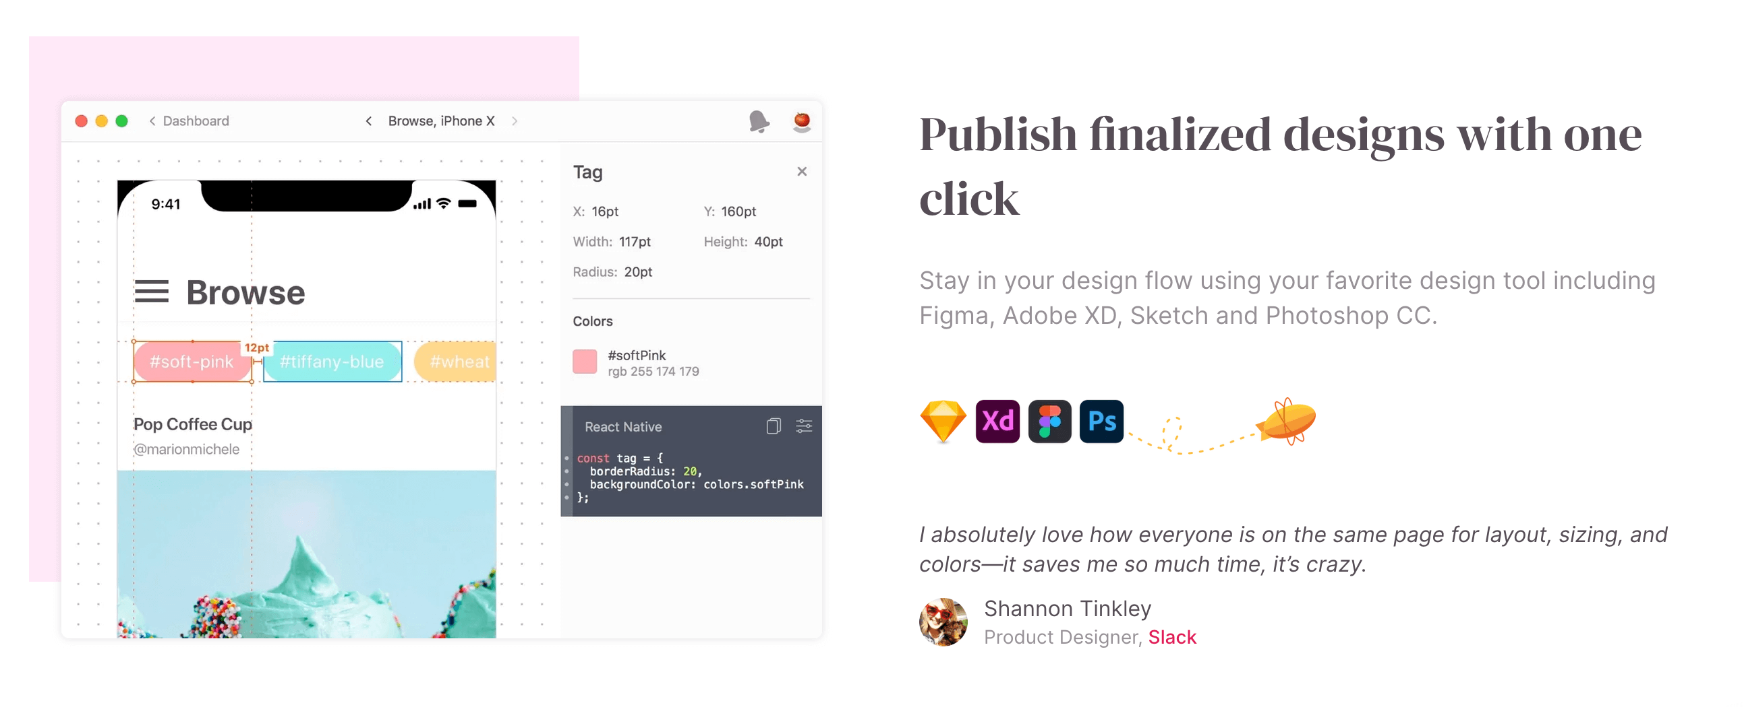
7. Zeplin

Slide 26
Key features:
Flows to quickly and easily map user journeys and document your designs.
Global Styleguides to organise and update your design system colours, text styles and components in a centralised location.
Integrations with Figma, Adobe XD, Sketch, Photoshop, Slack, and more.
Extensions for HTML, CSS, Swift, XML, React Native, and more.

Slide 27
8. Origami Studio
Origami Studio is a free design tool that was created by Facebook.
It’s primarily a prototyping tool, enabling designers to rapidly build and share interactive interfaces.
Originally built for designers at Facebook, Origami Studio is now available for free for macOS users.
It’s a sophisticated tool with a relatively steep learning curve, so we wouldn’t recommend it as your first UX/UI design tool.
But, for advanced designers looking to create life-like prototypes, it’s well worth your consideration.

Slide 28
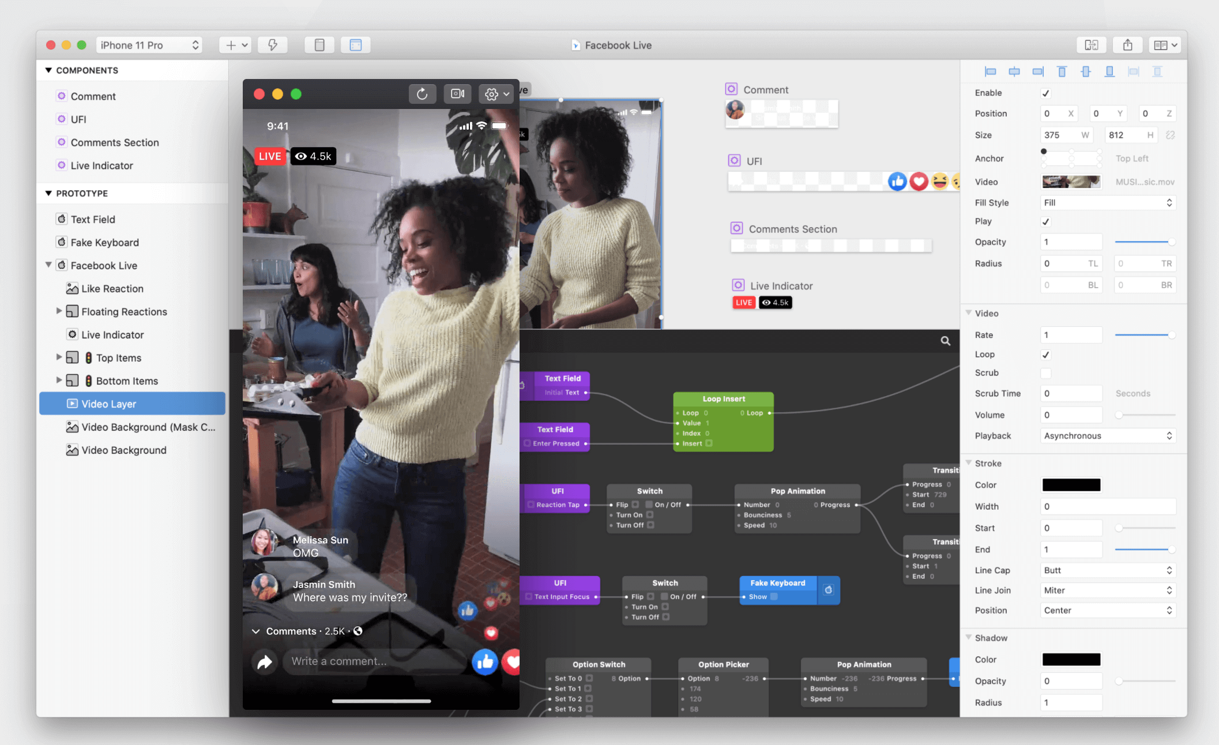
8. Origami Studio

Slide 29
Key features:
There are 6 main panels in Origami Studio:
The drag-and-drop canvas where you draw and edit shape layers, text and images which you’ve imported from Sketch or Figma
The Patch Editor: add interaction and animation to your prototype using blocks called “patches”
Layer List—a list of layers in your prototype. In this panel, you can add new layers to your prototype and add interactions to different layers
Inspector which allows you to select a layer and adjust its properties
The Viewer panel where you can view, interact with and record your prototype
The Patch Library containing a list of all available patches and their descriptions

Slide 30
9. Uizard
Uizard is a UI design platform for those who want to create digital products but don’t necessarily have advanced design expertise.
This is a comprehensive UX and UI tool encompassing ideation, low-fidelity wireframing, rapid prototyping, UI styling, and real-time collaboration.
Uizard stands out for its extremely low learning curve: according to their website, if you can use Google Slides, Keynote, or Powerpoint, you can use Uizard with ease!

Slide 31
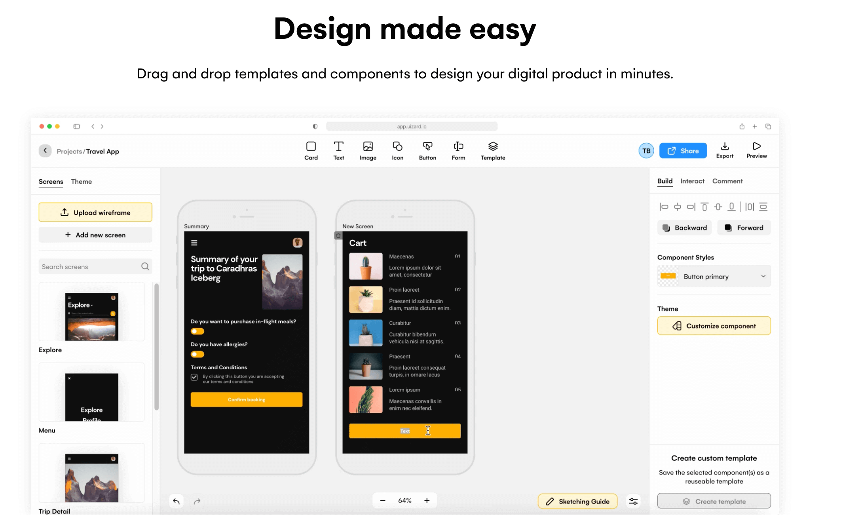
9. Uizard

Slide 32
Key features:
Drag-and-drop components and templates for quick mobile and web design
Wireframe mode which allows you to render your project in low-fidelity—ideal for taking a step back and considering the user experience of your product
Ability to import both hand-drawn paper wireframes and wireframes created using other tools. Uizard will transform your imported wireframes into customisable digital screens

Slide 33
Reference
https://www.uxdesigninstitute.com/blog/user-interface-ui-design-tools/
https://www.google.com/search?q=adobe+xd+used+for&oq=Adobe+XD+use&aqs=chrome.0.0i512j69i57j0i512l8.5412j0j15&sourceid=chrome&ie=UTF-8#fpstate=ive&vld=cid:544c3c76,vid:TfdrHObZ8zY

Slide 34
THANK YOU
For queries
Email: parveen.e13339@cumail.in

